Slide 1
GBM vs. XGBoost vs. LightGBM
Chris Kuo, Ph.D.| Columbia University

Slide 2
GBM vs. XGB vs. LightGBM
 | GBM | XGBoost | LightGBM
Full name | Gradient Boosting Machine | eXtreme Gradient Boosting | Light GBM
Data size | Medium | Large | Large
Training speed | Medium | Fast | Fast
Parallel Processing |  | Supported | Supported
Regularization |  | Yes
Overfitting | Likely | Controllable | Relatively serious
Author/contributor | Jerome Friedman | Tianqi Chen | Microsoft

Slide 3
XGB Features
Regularization: Xgboost used a more regularized model formalization to control over-fitting, which gives it better performance.”- Tianqi Chen
Speed: Computation in C++
Parallel process:
The algorithm was developed to efficiently reduce computing time and allocate an optimal usage of memory resources.
Block Structure to support parallelization in tree construction and the ability to fit and boost on new data added to a trained model
Faster in GBM in general
Important features of implementation include handling of missing values (Sparse Aware),
Faster training speed and higher efficiency

Slide 4
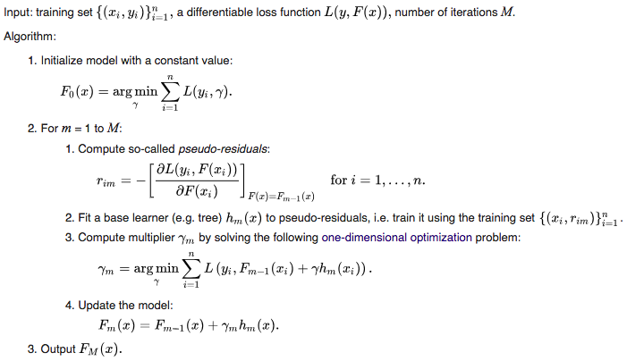
GBM In pseudocode

Slide 5

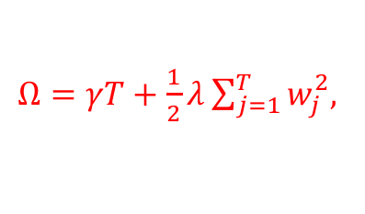
XGB In pseudocode
Objective function = Loss + Regularization
+ $Ω,$
$Ω=γT+\frac{1}{2}λ\sum_{j=1}^{T}{w_{j}^{2}}$,
Since we don't have derivative for every objective function, we calculate the second order taylor approximation of it

Slide 6

GBM Model Specification
The objective of any supervised learning algorithm is to define a loss function and minimize it.
Objective function = L
Assume Squared Error: MSE = $\sum{ (y_{i}}−{\hat{y}}_{i})^{2}$,
${\hat{y}}_{i}=ith target value$, $y_{i}=ith prediction$
Use gradient descent:
${\hat{y}}_{i+1}={\hat{y}}_{i}+λ\frac{δ\sum{(y_{i}−{\hat{y}}_{i})^{2}}}{δ{\hat{y}}_{i}}$, $λ$ is the learn rate

Slide 7
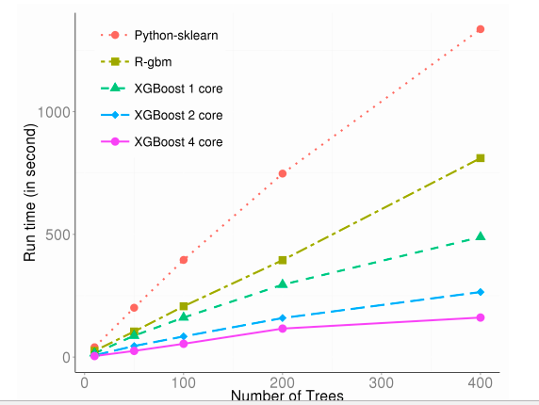
XGB runtime

Slide 8

XBG Model Specification
Regularization is an important part of the XGB model to present overfitting.
$Ω=γT+\frac{1}{2}λ\sum_{j=1}^{T}{w_{j}^{2}}$,
T is the number of trees and $w_{j}^{}$is the score of tree j
Objective function = L + $Ω$
Loss function $L(y_{i},{\hat{y}}_{i}$). Assume Squared Error
MSE = $\sum{ (y_{i}}−{\hat{y}}_{i})^{2}$,
${\hat{y}}_{i}=ith target value$, $y_{i}=ith prediction$
Use gradient descent:

Slide 9
LightGBM
Features:
Faster training speed and higher efficiency
Lower memory usage
Compatibility with large datasets
Parallel learning supported
Better accuracy than GBM/XGB

Slide 10
LightGBM
Leaf-wise to get higher level of accuracy
Tend to over-fit when data size is small
Use parameter max_depth to limit the depth of tree <=3
Level-wise tree growth
Leaf-wise tree growth

Slide 11
Work cited
Autoencoders were first introduced in the 1980s by Hinton.
Notes:
Summarize your research in three to five points.

